Slide 1
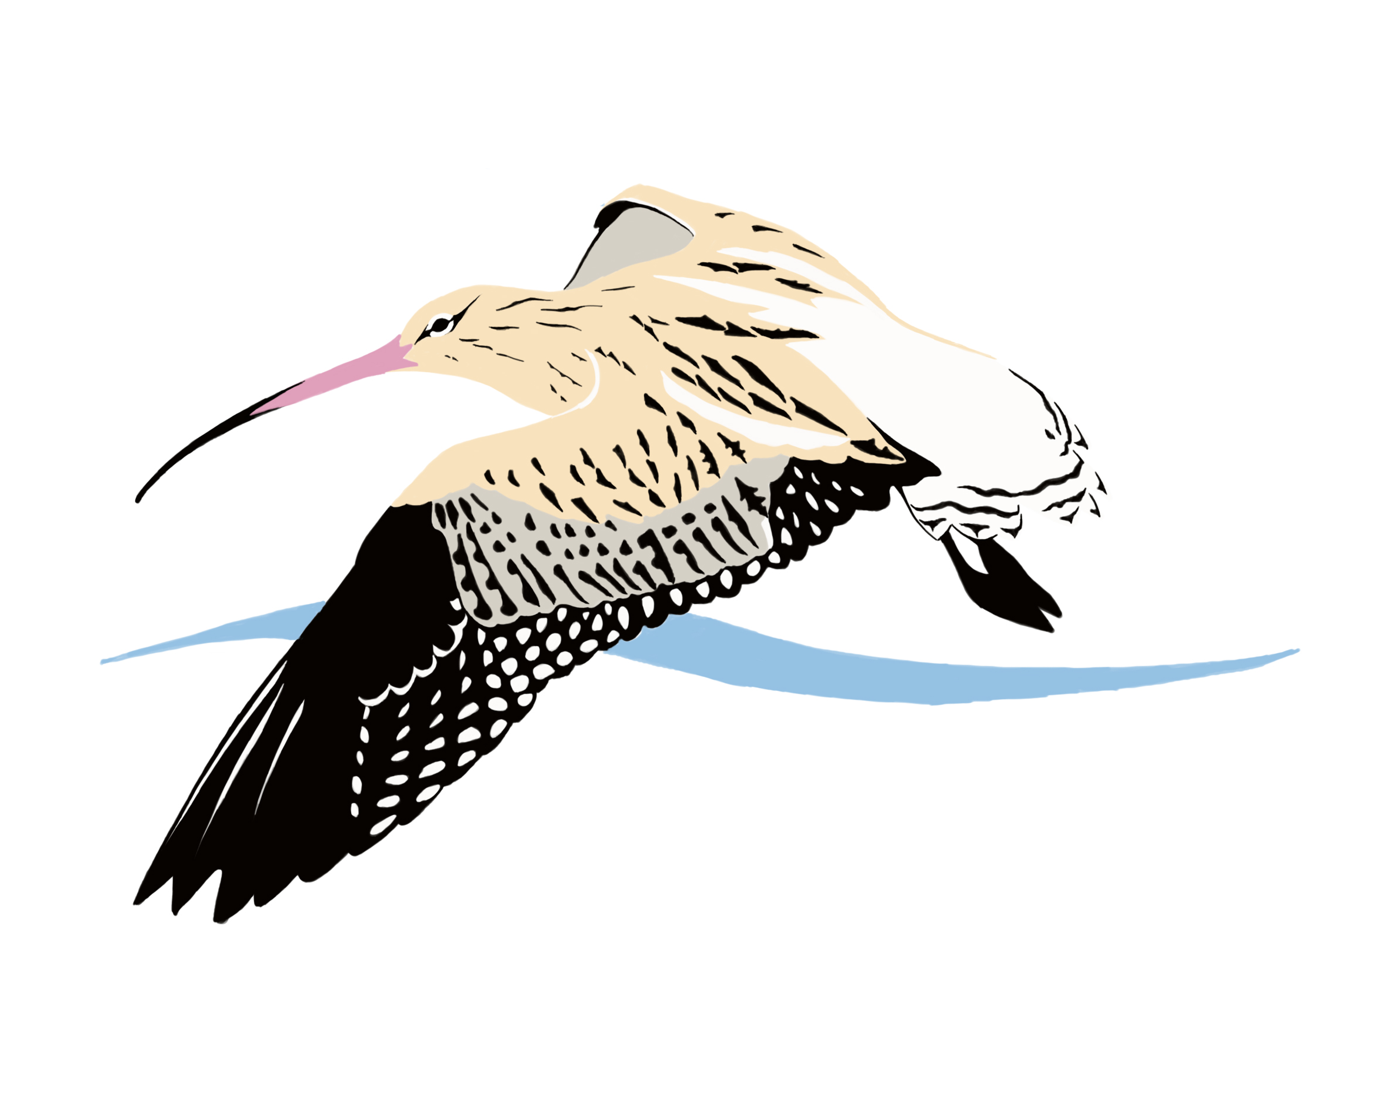
Current international work for the conservation of the Eurasian Curlew Numenius arquata: note for prospective funders
The below summaries are the 12 priorities for work between 2018 and 2021. They were agreed by the Eurasian Curlew International Working Group, a group consisting of Eurasian Curlew experts and governments signed up to the Agreement on the Conservation of Africa-Eurasian Waterbirds (AEWA)…
1. Conserving important breeding sites - We urgently need new resources at important breeding areas for Eurasian Curlew across Europe and Russia. This will pay for staff and equipment to monitor curlew and to coordinate and undertake site-specific conservation work. A network of these sites would improve our understanding of conservation techniques for curlew, how they are faring across different parts of their breeding range - and facilitate more international collaboration.
6. Understanding habitats – we need to better understand fine-scale habitat usage by curlews on their breeding grounds. Improved understanding of their ecological needs will help inform future conservation management.
7. Understanding food – this research topic is linked to the above one. Little information is available on the quality and availability of food for chicks.
8. Understanding migration – we need to analyse all the data and information in relation to curlew migration so as to better understand migratory connectivity between breeding and wintering regions and countries.
2. Expanded monitoring – we need to better understand population and demographic trends. Demographic parameters include things like breeding success and annual adult survival. We can do this by expanding and enhancing curlew surveys across the breeding range.
9. Understanding predation – we need to collate and exchange information on the effect predation is having on productivity so we have up-to-date information on this important topic.
3. Russian curlews – Russia is massively important for Russia, but estimates of population size are based on poor quality data. With extra resource, Russian experts could improve our understanding of how the species is faring in the country.
10. Understanding other threats – with an eye on the future, we need to collate information and the opinions of experts in relation to the things we don’t fully understand - but that might be impacting on curlew populations.
4. Guidance on monitoring – with the above plans focussed on encouraging more people to study curlews, we need to make sure they do so in a safe way and in a way that allows us to compare the results between different studies.
11. Letting people know – we need to make sure people know we are doing this work and why, so we can improve support across the flyway.
5. Ensuring any hunting is sustainable – hunting in France is a divisive topic. We need hunters, scientists, hunters and conservationist to come together to ensure that if hunting is to continue in the future, it is sustainable and based on the latest scientific evidence
12. Future rural development guidance - In many countries, the fate of curlew populations is heavily influenced by wider decisions on farming and other land uses such as forestry and wind farms. We need to produce guidance on these policies to help ensure curlew conservation is accounted for in future policy discussions and decisions.
For more information please visit https://www.unep-aewa.org/en/meeting/1st-meeting-aewa-eurasian-curlew-international-working-group-na-arquata-breeding-range or contact Daniel Brown, Coordinator of the AEWA international working group via Daniel.brown@rspb.org.uk . Background image courtesy of Szabolcs Nagy.

